Slide 1


HOSPITAL MANAGMENT SYSTEM
Submitted By
Team Member: 01
Sanjida Khanom
0562310005101008
Spring:2023
Duration
2024 DEC-16th

Slide 2

Welcome
User Research
Welcome to the Presentation on Hospital Management System
Efficient Healthcare System for Modern Hospitals.

Slide 3
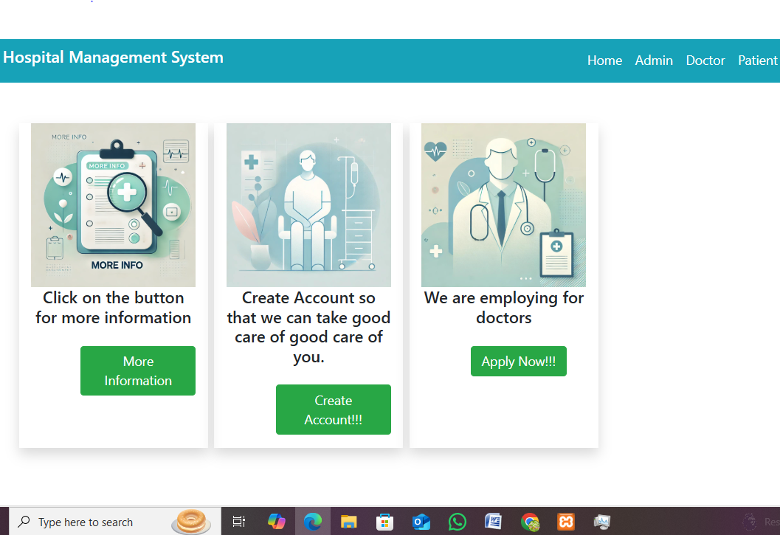


Slide 4


Overview
Motivation Behind the Project
1.Challenges in traditional hospital management:
2.Inefficient patient record handling.
3.Difficulty in appointment management
4.Limited access to income and report tracking.
Goal
A comprehensive system that integrates admin, doctor, and patient workflows.

Slide 5

Technologies Used
Frontend: HTML, CSS, Bootstrap
Backend: PHP(Core PHP Framework)
Database: MySQL

Slide 6
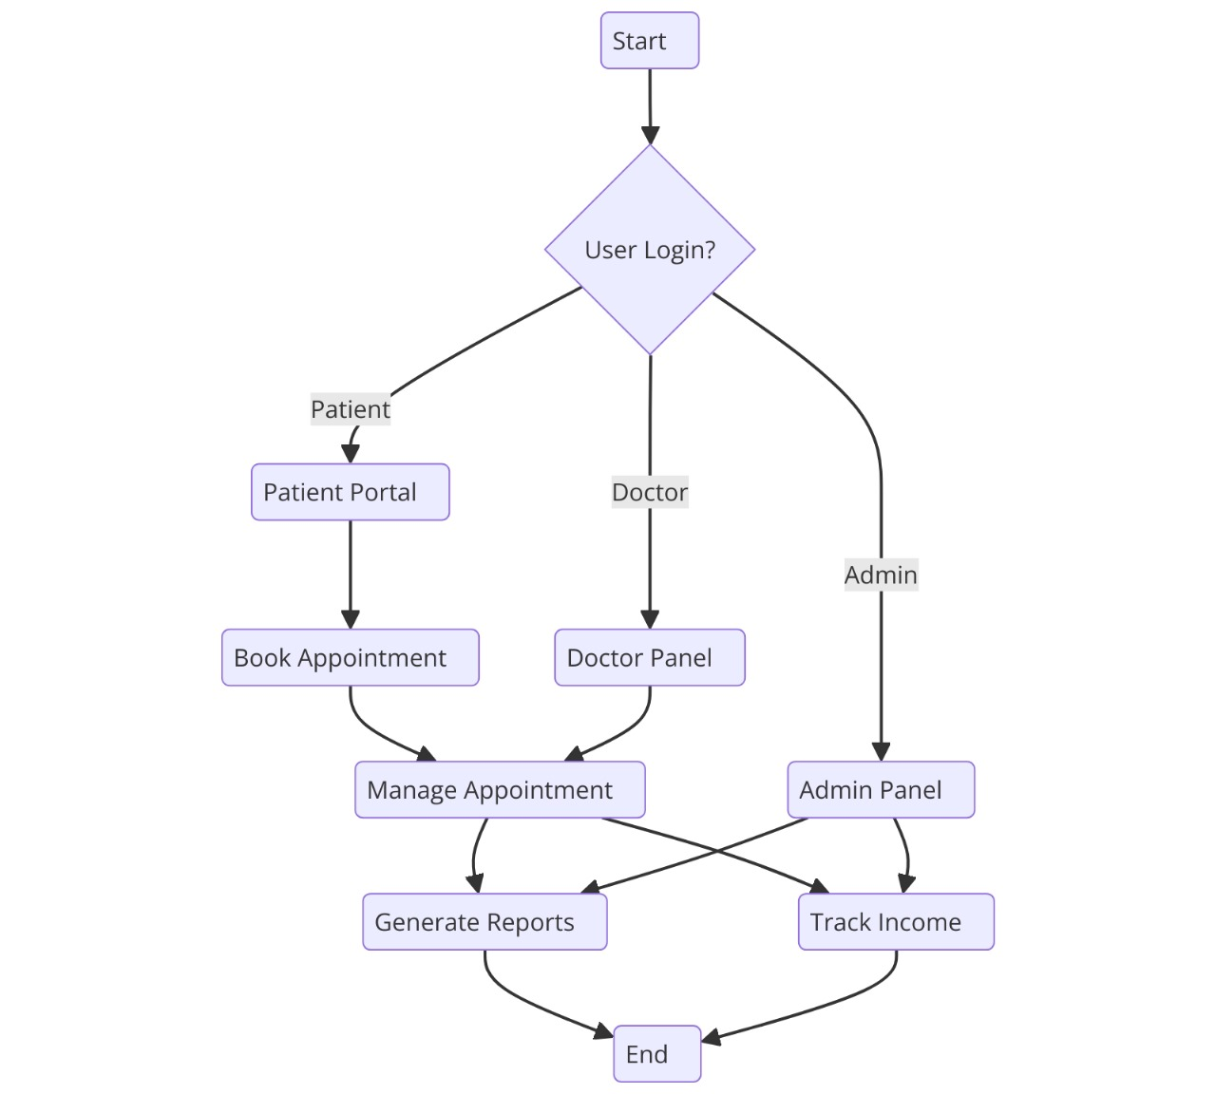

Slide 7
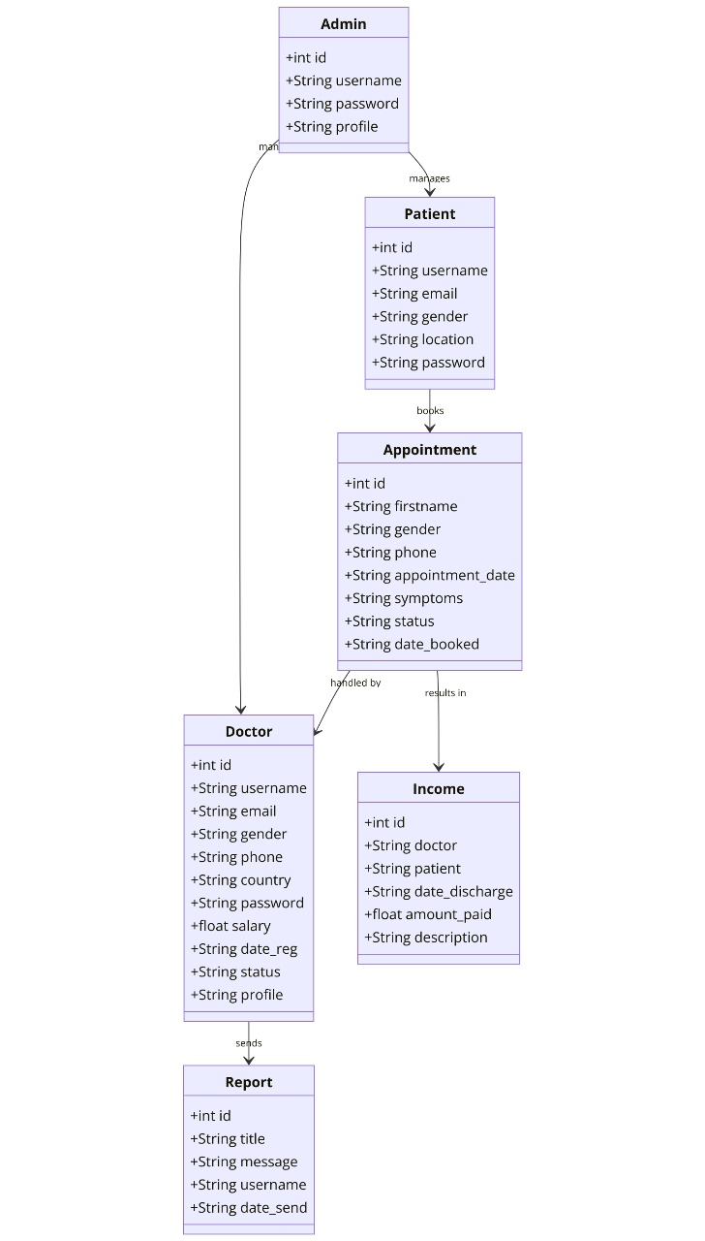

Slide 8
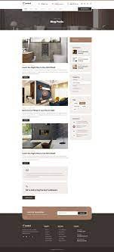
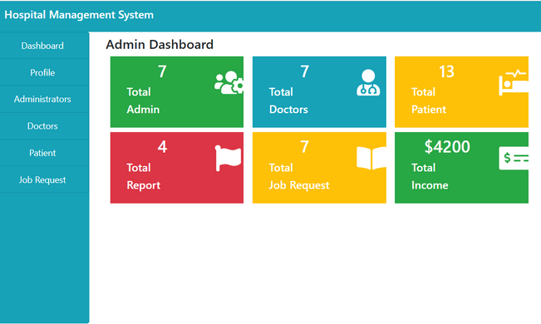
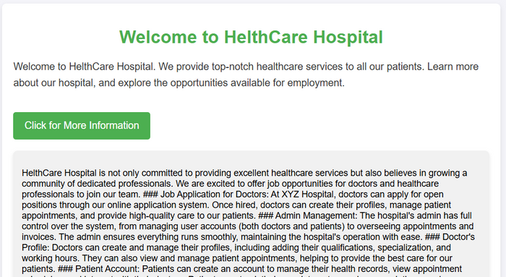
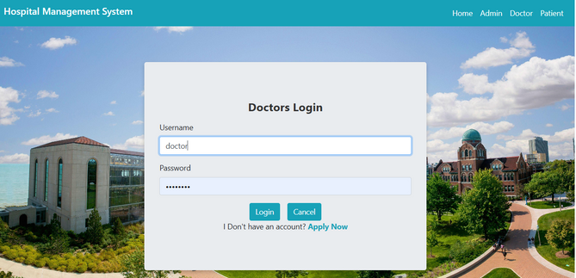
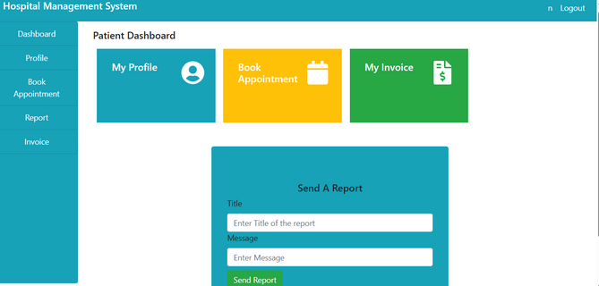
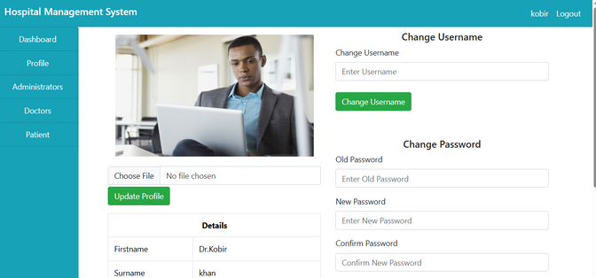
Key Features
User Research
Admin Panel: Secure login, manage users.
Doctor Management: Profile setup, salary records.
.
Appointment Scheduling: Easy booking, status tracking.
.
Income Tracking: Discharge records and payments.
Reports: Generate and manage feedback and queries

Slide 9


